Slide 1
休閒餐飲管理觀光旅遊全文資料庫
Hospitality & Tourism Complete™

Slide 2
Hospitality & Tourism Index (HTI)
* Contains over 1.2 million records
Articles in Hospitality and Tourism
Co-Produced by the University of Surrey and Oxford Brookes
Hospitality Database
Produced by Cornell University
Other Relevant Hospitality & Tourism Literature
Not Previously Covered by These Databases
Lodging, Restaurant & Tourism Index
Produced by Purdue University

Slide 3
Make-Up of Hospitality & Tourism Complete
Also includes market research reports on restaurants & foodservice and travel & tourism
Conference proceedings
collections
All indexing & abstracts from HTI
Full-text journals & magazines including Hotel Management, International Journal of Tourism Research, Restaurant Business, Restaurant Hospitality, Tourism & Hospitality Management, etc.
Full-text books & monographs including The Encyclopedia of Tourism

Slide 4
Journal Breakdown
 | TOTAL | NOT Available via Business Source Elite | NOT Available via Business Source Premier | NOT Available via Business Source Complete | NOT Available via Business Source Ultimate
Full-Text Journals | 260 | 243 | 203 | 197 | 197
Also includes 58 full-text books & monographs not available in full text in any version of Business Source
Figures from February 2018

Slide 5
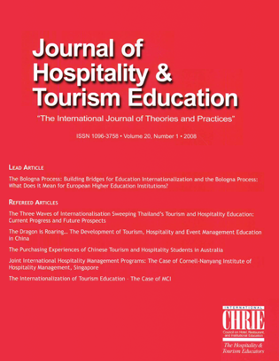
Hospitality & Tourism Complete Contains the Journal of Hospitality & Tourism Education
The #1 hospitality & tourism education journal
An award-winning, refereed, interdisciplinary quarterly journal
Full text from 2005 to present
Not available in full text in other EBSCOhost databases
Not available with active full text in databases from other vendors

Slide 6
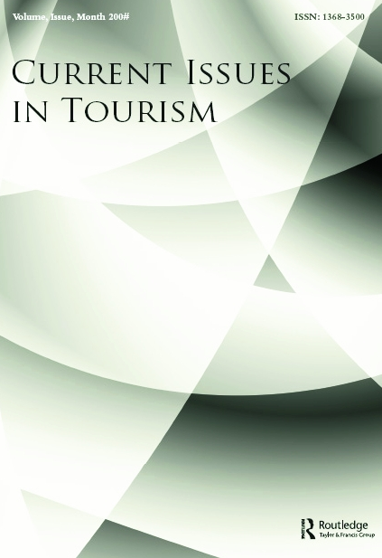
Hospitality & Tourism Complete Contains Current Issues in Tourism
A top ranked publication containing both applied and theoretical work that addresses tourism inquiry, method and practice
Not available with active full text in databases from other vendors

Slide 7
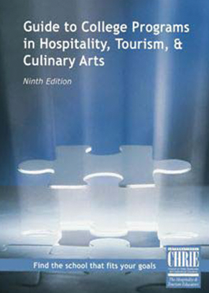
Hospitality & Tourism Complete Contains the Guide to College Programs in Hospitality, Tourism & Culinary Arts, Ninth Edition
The only complete guide to accredited programs in hospitality and tourism
An essential resource for prospective students and industry employees seeking advancement through education, career counselors, corporate recruiters and industry organizations
This publication provides listings by specialization and geographic location detailing educational opportunities available at two-year, four-year, and graduate-level hospitality and tourism programs in North America and abroad
Each detailed listing in the Guide covers the “vital statistics” of each program – student enrollment, program features, accreditation, admission and graduation requirements, and financial aid sources. The Guide to College Programs also offers a wealth of scholarship information

Slide 8
Online Demo
線上操作

